Slide 1
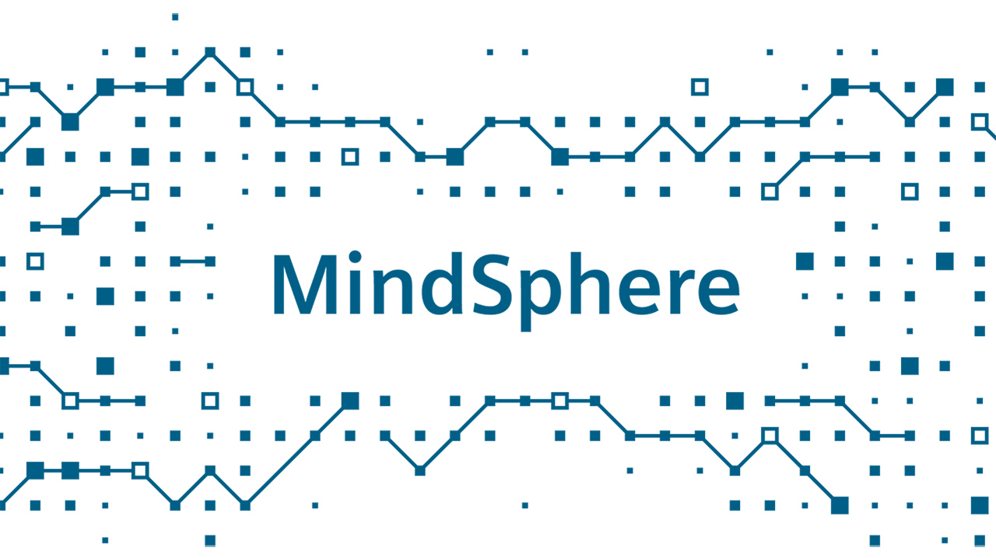
Profesor: Dragan H. Stojanović
Student: Jelena Živković, 16581

Slide 2
MindSphere
MindSphere je vodeća platforma kao servis za razvoj IoT rešenja u industriji.
MindSphere je razvio Siemens koji važi za vodeću firmu u oblasti industrijske automatizacije.
MindSphere nudi:
sigurno rešenje za smeštaj podataka, razvoj i izvršavanje aplikacija,
pripremljena rešenja za povezivanje uređaja, poslovnih aplikacija i baza podataka,
Siemens open API,
Alate za brzi razvoj robusnih IoT industrijskih aplikacija sa pripremljenim naprednim alatima za analitiku,
Globalna skalabilnost bazirana na svetski najvećim provajderima.
Notes:
MindSphere is a leading industrial IoT as a service solution ^{[1]} developed by Siemens for applications in the context of the Internet of Things (IoT).^{[2]} MindSphere stores operational data and makes it accessible through digital applications (“MindSphere applications”) to allow industrial customers to make decisions based on valuable factual information
MindSphere offers you:
Secure, end-to-end solutions for connecting devices, storing data and developing and running applications
Extensive device, enterprise and database connectivity options to support a variety of IoT-ready assets
Industrial IoT as a service solution with numerous options for data exchange using Siemens open application programming interfaces (APIs) and native cloud accessibility
Fast development of robust industry-driven IoT solutions with advanced analytics capabilities
Combined global scalability of Siemens, the number one automation provider, with the world’s largest cloud providers

Slide 3
MindSphere – Industrijski IoT kao servis
MindApps (Aplikacije)
Korišćenje gotovih aplikacija Siemens-a, njegovih partnera ili razvoj sopstvenih aplikacija
Pruža transparentan pristup asetima & analitički uvid
Cenovni model baziran na pretplati
MindSphere
MindSphere (Otvorena PaaS)
Otvoreni interfejs za razvoj korisničkih aplikacija
Različite infrastrukture u oblaku: AWS, Microsoft Azure, Alibaba
10
01
01
11
00
10
01
00
11
10
01
00
11
10
01
01
11
10
01
01
11
10
01
01
11
01
10
01
01
00
10
01
01
00
MindConnect (Povezivanje)
10
01
01
11
10
01
01
11
10
01
01
11
10
01
01
11
10
01
01
11
01
00
11
10
10
01
01
00
01
00
11
10
Otvoreni standardi za povezivanje aseta-a, npr. OPC UA
Već pripremljeni „Plug and play“ proizvodi za povezivanje na MindSphere-u
Sigurna i kriptovana komunikacija podataka
Notes:
U početku je Siemens MindSphere-u nazivao – The cloud-based, open IoT operating system from Siemens
Siemens calls MindSphere a cloud-based IoT operating system for the analysis of IoT data. (https://www.opc-router.com/siemens-mindsphere-iot-mqtt-connection/)

Slide 4
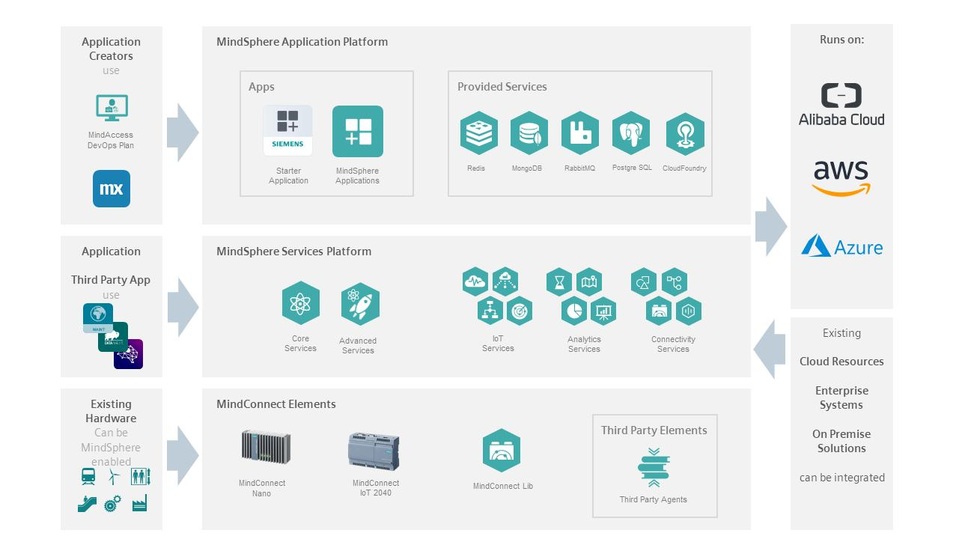
MindSphere
Notes:
With MindSphere, companies can connect real-world products, factories, machines, and systems to extract and analyze real-world performance and application data. Data analysis can obtain relevant information and analysis results from the original data.

Slide 5
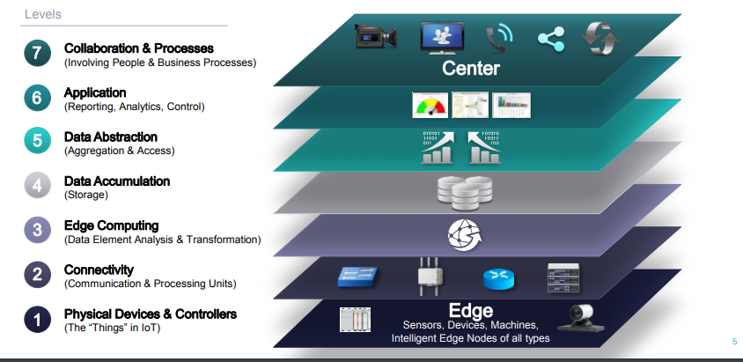
IoT World Forum Reference Model
Notes:
https://www.altexsoft.com/blog/iot-architecture-layers-components/

Slide 6
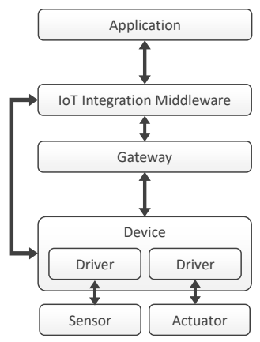
IoT – The reference architecture
The prototype
Sensors
Device:
Gateway: MindConnectNano, MindConnectIoT2040, MindConnectLib
IoT Integration Middleware: MindSphere
Application:
IoT reference architecture
Notes:
https://medium.com/@bertrand.jan/tell-me-more-internet-of-things-part-3-mindsphere-cost-and-value-comparison-b333ebfb872a
----
https://www.iaas.uni-stuttgart.de/publications/INPROC-2016-48-Comparison-of-IoT-Platform-Architectures.pdf
A. Sensor
A Sensor is a hardware component, which is used to measure parameters of its physical environment and to translate them into electrical signals, for example, by measuring the temperature or humidity of a room. If required, a Sensor may be configured using software, but cannot run software itself. Typically, Sensors are connected to or are integrated into a Device to which the gathered data is sent. Prominent examples for Devices are RaspberryPis, BananaPis, the Arduino boards, or BeagleBones. The connection can be established by wires or wireless, for instance, via radio.
B. Actuator
An Actuator is a hardware component, which can act upon, control, or manipulate the physical environment, for example, by giving an optic or acoustic signal. Actuators receive commands from their connected Device. They translate
electrical signals into some kind of physical action. Just like Sensors, Actuators are typically connected to or are even integrated into a Device, whereby the connection can be established by wires or wirelessly. If required, Actuators can be
configured using software but cannot run software themselves.
C. Device
A Device is a hardware component, which is connected to Sensors and/or Actuators via wires or wirelessly or even integrates these components. To process data from Sensors and to control Actuators, typically software in the form of Drivers is required. A Driver in our architecture enables other software on the Device to access Sensors and Actuators. It represents the first possibility to use software to process data produced by Sensors and to control Actuators influencing the physical environment. Thus, Devices are the entry point of the physical environment to the digital world. Devices are either (i) selfcontained or (ii) connected to another system, e.g., to an IoT Integration Middleware. If they are self-contained, they build a black box of functionality, e.g., to control an air-conditioner by evaluating data from a connected temperature Sensor.
D. Gateway
Devices are often connected to a Gateway in cases when the Device is not capable of directly connecting to further systems, e.g., if the Device cannot communicate via a particular protocol or because of other technical limitations. To solve these problems, a Gateway is used to compensate such limitations by providing required technologies and functionalities to translate between different protocols and by forwarding communication between Devices and other systems. A Gateway is, therefore, responsible for supporting the required communication technologies and protocols in both directions and for translating data if necessary. For instance, a Device communicates with a Gateway via an IoT protocol, such as ZigBee or MQTT.
When the Gateway receives a message in a proprietary binary format from the Device, the Gateway translates the information into JSON or XML and forwards the data to a system in the world wide web. Likewise, the Gateway may translate commands into communication technologies, protocols, and formats supported by the respective Device. The Gateway may already execute some data processing functions, such as data aggregation, depending on its processing capabilities.

Slide 7
MindSphere – Osnovne funkcije
Osnovne funkcije:
Kreiranje i upravljanje korisnicima,
Kreiranje, upravljanje i ažuriranje „asset“-a (sredstava) u MindSphere-i
Posredstvom MindConnect-a prikupljanje podataka sa uređaja u polju (S7, OPC UA protokolima) i prenos u MindSphere-u,
Vizuelizacija i osvežavanje podataka (vremenskih serija – eng. time series)
Prikaz pojedinih podataka, kao i statusa „asset“-a,
Upravljanje „asset“-ima i upravljanje online sredstvima
Razvoj novih aplikacija
Izvor: https://www.programmersought.com/article/77513966958/
Notes:
Osnovne funkcije:
MindConnect – pripremljena hardverska i softverska rešenja za prenos podataka u MindSphere-u,
MindConnect IoT Extension – pripremljena rešenja za implementaciju agenata za različite protokole u polju,

Slide 8
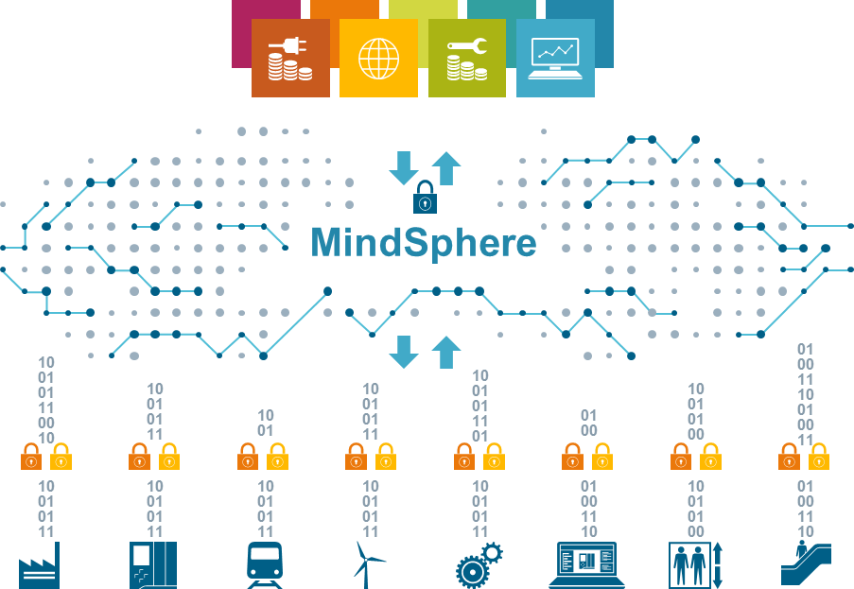
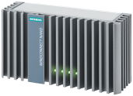
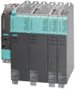
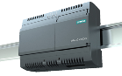
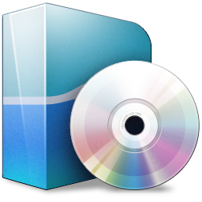

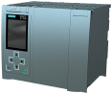
MindConnect – Osnovne karakteristike
MindConnect osnovne karakteristike:
Pripremljeni uređaji MindConnect Nano, MindConnect IoT2040 i softverski blok MindConnect FB za Siemens PLC S7-1500.
MindConnect ugrađen u standardne Siemens industrijske uređaje, npr. SINUMERIK (kontroler za CNC mašine) i RUGGEDCOM (napredna mrežna oprema)
MindConnect Software, API-i i biblioteke za integraciju u same asete (uređaje)
Ključne osobine MindSphere kompleta za povezivanje
IoT Konektori čije je fokus na postojećim (brownfield) sistemima: MindConnect Nano i MindConnect
IoT2040
MindConnect ugrađeni Agenti u standardnim Siemens industrijskim proizvodima čiji je fokus
na novim (greenfield)
sistemima
npr. SIMATIC, Sinumerik
MindConnect Software, MindConnect API-i i MindConnect Lib za razvoj novih proizvoda, uključujući „3rd-party“ (ne Siemens)
1
2
3
MindConnect SW
Windows / Linux
MindConnect Lib
Notes:
MindConnect Main Characteristics:
Dedicated IoT Connectors with MindConnect Nano, MindConnect IoT2040 and MindConnect FB S7-1500 (with engineering via TIA Portal v14, …)
MindConnect embedded in standard Siemens industrial products, e.g. SINUMERIK and RUGGEDCOM
Upcoming MindConnect Software, APIs and Libraries for own integration into assets / devices

Slide 9
MindSphere APIs
Karakteristike MindApps API-a:
MindSphere Application Programming Interface (API) za razvoj aplikacija u vlasništvu korisnika (MindApps)
Optimizovani za razvoj industrijskih IoT aplikacija sa dopunskim modulima (npr. parsing, i moduli za analitiku i vizuelizaciju)
Obezbeđuje skalabilnost aplikacija
Ključne osobine za MindApp API-e
1
Razvojni alati za standardna razvojna okruženja (IDEs) Eclipse, IntelliJ.
Dopunski IoT moduli za određene slučajeve (npr. parsing, analitika i moduli za vizuelizaciju).
2
MindSphere App prodavnica obezbeđuje brojne spremne aplikacije (MindApps)
App prodavnica nudi programerima kanal za promociju i monetarizaciju
3
Zajednica programera podržana je preko Developer Portal-a, Developer Conference-a, savetovanje, besplatnih demo apps, i još mnogo toga
Notes:
MindSphere APIs – scalable application and connectivity development
Taking advantage of future innovation of platform and connectivity

Slide 10
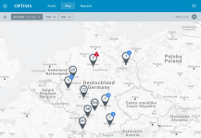
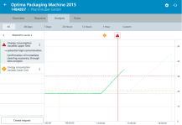
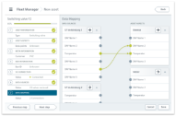
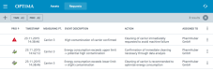
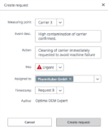
Servisi pokretani podacima bazirani na MindSphere-i omogućavaju nove poslovne mogućnosti
MindSphere – klaud bazirani, otvoreni
IoT operativni sistem
Uvid
Neposredni uvid u celu flotu i pojedinačne asset-e korišćenjem sopstevnih, Siemens ili partnerskih aplikacija,
Virtuelni svet
MindSphere
Stvarni svet
Podaci
Akcija
10
01
01
11
00
10
10
01
01
11
01
01
00
11
10
01
00
11
Transformacija podataka u efikasne rezultate u cilju povećanja vremena rada i efikasnosti
10
01
01
11
10
01
10
01
01
11
01
00
10
01
01
00
Konfigurisanje kolekcija podataka kao i veza brzo i lako
10
01
01
11
10
01
01
11
10
01
01
11
10
01
01
11
10
01
01
11
01
00
11
10
10
01
01
00
01
00
11
10
Notes:
Action
Transform insights into actionable results to increase uptime and efficiency
Data
Configure data collection as well as connectivity quickly and easily

Slide 11




VIZIJA: Ekosistem MindSphere-e obezbeđuje vrednost različitim učesnicima i omogućava između njih razmenu vrednosti
Kosirsnici servisa npr. koriste servise pokretane podacima i aplikacije kao servise koji rade na MindSphere-i
obezbeđuju servise pokretane podacima
Pružaoci servisa npr. proizvođači mašina kreiraju i nude servise pokretane podacima koji
koriste aplikacije i module
obezbeđuju aplikacije / module
Software developer
Kreiraju i nude aplikacije i module
Market place
Za servise pokretane podacima
Market place
Za aplikacije i module
Pruža sigurno i standardno skladište podataka
Obezbeđuje okruženje, alate i komponente za vezu u cilju realizacije servisa
Obezbeđuje razvojno / test okruženje i alate
MindSphere
platforma, alati, servisi (usluge)
Notes:
VISION: The MindSphere ecosystem provides value to different participants and enables them to provide value between themselves
machine builder
create and offer data-driven services using applications and modules
e.g. plant operators use data-driven services and apps as a service running on MindSphere
Provides secure and common data storage
Provides environment, tools and connectivity components to create services
Provides dev. / test environment and tools
Provides environment, tools and connectivity components to create services
Provides dev. / test environment and tools

Slide 12



MindSphere nudi sigurnosni koncept
Visoko skalabilna, cenovno efikasna cloud infrastruktura bazirana na Cloud Foundry
Najveći sigurnosni standardi
MindConnect Elements bazirani na ICS (Industrial Controls System) sigurnosti orijentisanoj na industrijskom standardu IEC 62443
MindSphere Platform IT sigurnosno orijentisan na industrijskim standardima ISO 27001, IEC 62443, BSI
Podaci u mirovanju (data in rest) se nalaze u datacentrima koji su u skladu sa svim potrebnim sertifikatima
Podaci u kretanju (data in motion) su uvek najmanje 256 bit SSL/TLS šifrovani
Maksimum poverljivosti
Korisnici upravljaju nivoima ovlašćenja i vlasnici su svojih podataka
Siemens ima ulogu čuvara podataka
Notes:
Cloud Foundry provides a highly efficient, modern model for cloud native application delivery on top of Kubernetes.
ISO/IEC 27001 is widely known, providing requirements for an information security management system (ISMS), though there are more than a dozen standards in the ISO/IEC 27000 family. Using them enables organizations of any kind to manage the security of assets such as financial information, intellectual property, employee details or information entrusted by third parties.
IEC 62443 is an international series of standards on "Industrial communication networks - IT security for networks and systems". The standard is divided into different sections and describes both technical and process-related aspects of industrial cybersecurity. It divides the industry into different roles: the operator, the integrators (service providers for integration and maintenance) and the manufacturers. The different roles each follow a risk-based approach to prevent and manage security risks in their activities.
Data at rest generally refers to data stored in persistent storage (disk, tape).
MindSphere offers industry hardened, holistic security concept

Slide 13
Lokacije data centara
MindSphere se može licencirati u različitim regionima na različitim data centrima.
Sledeća tabela prikazuje regione i lokacije data centara za svaki region:
Region | Lokacija data centra | MindSphere dobavljač infrastrukture
Europe 1 | Frankfurt, Germany (eu1) | Amazon Web Services
Europe 2 | Amsterdam, Netherlands (eu2) | Microsoft Azure
China 1 | Shanghai, China (cn1) | Alibaba Cloud
Notes:
https://documentation.mindsphere.io/resources/html/mindsphere-regions/en-US/122585486347.html

Slide 14
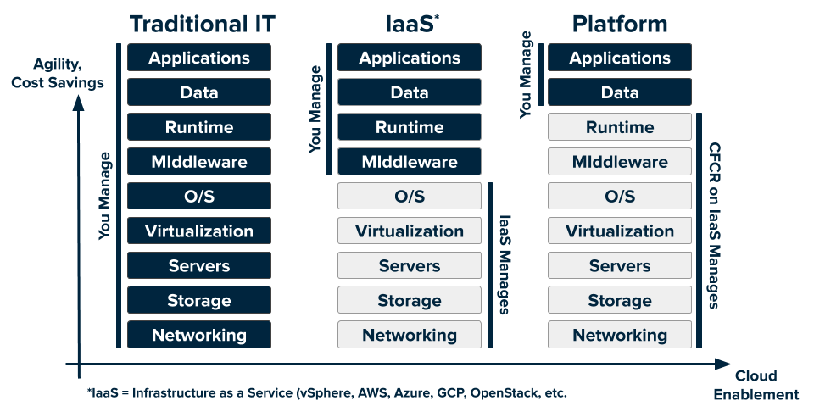
Platforma kao servis (PaaS)
Notes:
Cloud platforms let anyone deploy network apps or services and make them available to the world in a few minutes. When an app becomes popular, the cloud scales it to handle more traffic, replacing build-out and migration efforts that once took months with a few keystrokes. Cloud platforms enable you to focus exclusively on your apps and data without worrying about underlying infrastructure.
From <https://docs.cloudfoundry.org/concepts/overview.html>
Infrastructure-as-a-Service (IaaS), which provides only a base infrastructure, leaving the end user responsible for the platform and environment configurations necessary to deploy applications. Amazon Web Services and Microsoft Azure are prime examples of IaaS.
Software-as-a-Service (SaaS), which provide a finished product for end users, such as Gmail or Salesforce.
Platform-as-a-Service (PaaS), which helps to reduce application development overhead (i.e. environment configuration) by providing a ready-to-use platform. PaaS services can be hosted on top of infrastructure provided by an IaaS.
From <https://cloudacademy.com/blog/cloud-foundry-benefits/>

Slide 15
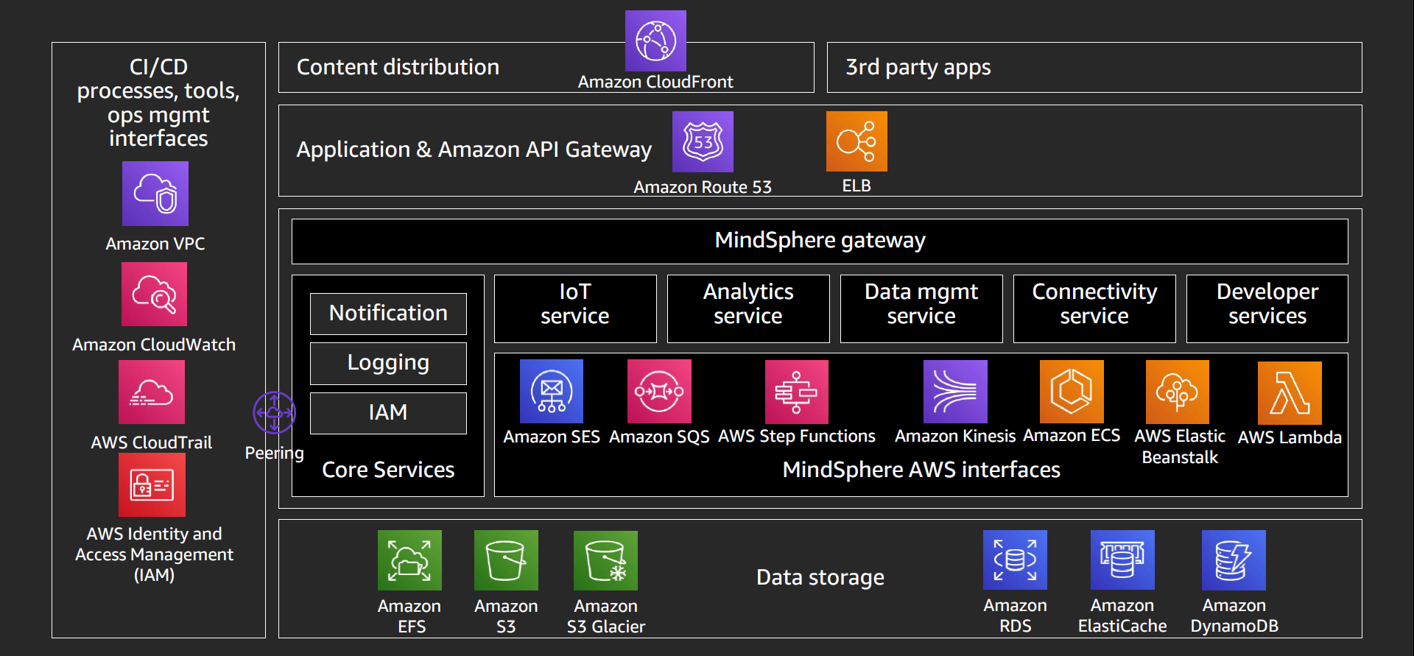
MindSphere na AWS - pregled
Notes:
Continuous integration (CI) and continuous delivery (CD)
Amazon Virtual Private Cloud (Amazon VPC) is a service that lets you launch AWS resources in a logically isolated virtual network that you define.
Amazon CloudWatch enables you to collect, access, and correlate this data on a single platform from across all your AWS resources, applications, and services ..
AWS CloudTrail is a service that enables governance, compliance, operational auditing, and risk auditing of your AWS account. With CloudTrail, you can log, ...
AWS Identity and Access Management (IAM) enables you to manage access to AWS services and resources securely. Using IAM, you can create and manage ...
Content distribution
Amazon CloudFront is a fast content delivery network (CDN) service that securely delivers data, videos, applications, and APIs to customers globally with low latency, high transfer speeds, all within a developer-friendly environment.
Application & Amazon API Gateway
Amazon Route 53 is a highly available and scalable cloud Domain Name System (DNS) web service. It is designed to give developers and businesses an extremely reliable and cost effective way to route end users to Internet applications by translating names like www.example.com into the numeric IP addresses like 192.0.2.1 that computers use to connect to each other. Amazon Route 53 is fully compliant with IPv6 as well.
Elastic Load Balancing automatically distributes incoming application traffic across multiple targets, such as Amazon EC2 instances, containers, IP addresses, ...
MindSphere AWS interfaces
Amazon Simple Email Service (SES) is a cost-effective, flexible, and scalable email service that enables developers to send mail from within any application.
Amazon Simple Queue Service (SQS) is a fully managed message queuing service that enables you to decouple and scale microservices, distributed systems, and serverless applications.
AWS Step Functions is a serverless function orchestrator that makes it easy to sequence AWS Lambda functions and multiple AWS services into business-critical applications. Through its visual interface, you can create and run a series of checkpointed and event-driven workflows that maintain the application state.
Amazon Kinesis enables you to ingest, buffer, and process streaming data in real-time, so you can derive insights in seconds or minutes instead of hours or days.
Amazon Elastic Container Service (Amazon ECS) is a fully managed container orchestration service. Customers such as Duolingo, Samsung, GE, and Cookpad use ECS to run their most sensitive and mission critical applications because of its security, reliability, and scalability.
AWS Elastic Beanstalk is an easy-to-use service for deploying and scaling web applications and services developed with Java, .NET, PHP, Node.js, Python, Ruby, Go, and Docker on familiar servers such as Apache, Nginx, Passenger, and IIS.
AWS Lambda is a compute service that lets you run code without provisioning or managing servers. Lambda runs your code on a high-availability compute infrastructure and performs all of the administration of the compute resources, including server and operating system maintenance, capacity provisioning and automatic scaling, code monitoring and logging. With Lambda, you can run code for virtually any type of application or backend service. All you need to do is supply your code in one of the languages that Lambda supports.
Data storage
Amazon Elastic File System (Amazon EFS) provides a simple, serverless, set-and-forget, elastic file system that lets you share file data without provisioning or managing storage.
Amazon Simple Storage Service (Amazon S3) is an object storage service that offers industry-leading scalability, data availability, security, and performance.
Amazon S3 Glacier and S3 Glacier Deep Archive are a secure, durable, and extremely low-cost Amazon S3 cloud storage classes for data archiving and long-term backup.
Amazon Relational Database Service (Amazon RDS) makes it easy to set up, operate, and scale a relational database in the cloud.
Amazon RDS is available on several database instance types - optimized for memory, performance or I/O - and provides you with six familiar database engines to choose from, including Amazon Aurora, PostgreSQL, MySQL, MariaDB, Oracle Database, and SQL Server. You can use the AWS Database Migration Service to easily migrate or replicate your existing databases to Amazon RDS.
Amazon ElastiCache allows you to seamlessly set up, run, and scale popular open-source compatible in-memory data stores in the cloud. Amazon ElastiCache offers fully managed Redis, voted the most loved database by developers in the Stack Overflow 2020 Developer Survey, and Memcached for your most demanding applications that require sub-millisecond response times.
Amazon DynamoDB - Fast and flexible NoSQL database service for any scale
---
Amazon Athena is an interactive query service that makes it easy to analyze data in Amazon S3 using standard SQL. Athena is serverless, so there is no infrastructure to manage, and you pay only for the queries that you run.
Amazon Redshift - Analyze all of your data with the fastest and most widely used cloud data warehouse. With Redshift, you can query and combine exabytes of structured and semi-structured data across your data warehouse, operational database, and data lake using standard SQL. Redshift lets you easily save the results of your queries back to your S3 data lake using open formats, like Apache Parquet, so that you can do additional analytics from other analytics services like Amazon EMR, Amazon Athena, and Amazon SageMaker.
Amazon Simple Notification Service (Amazon SNS) is a fully managed messaging service for both application-to-application (A2A) and application-to-person (A2P) communication.

Slide 16
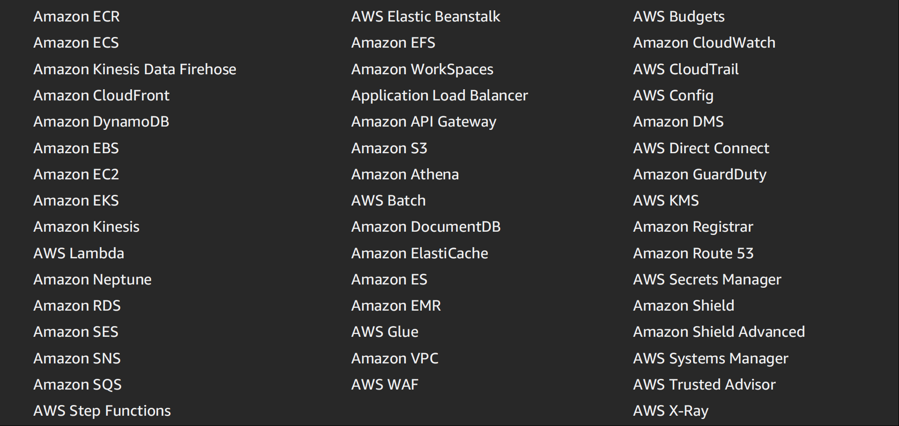
AWS servisi koje koristi Mindphere u 2019. godini

Slide 17
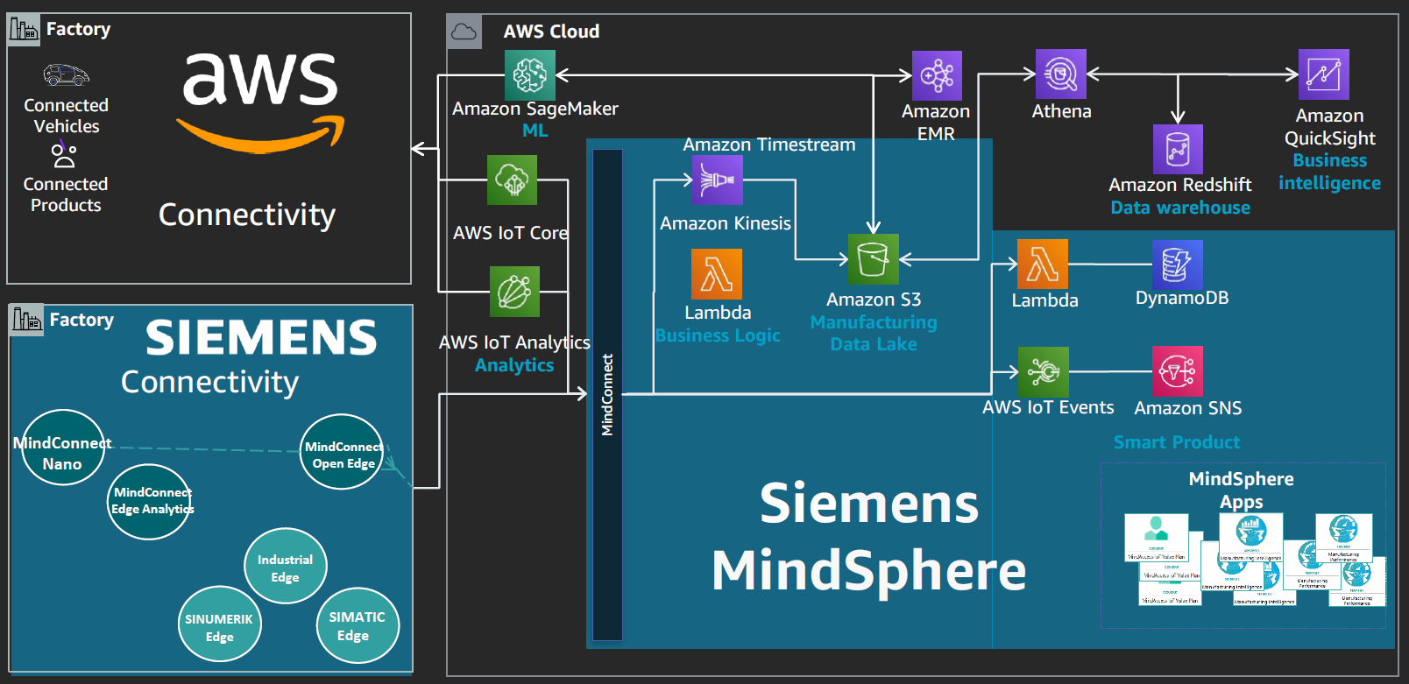
MindSphere + AWS ubrzava rešenja
Notes:
Amazon Simple Storage Service (Amazon S3) is an object storage service that offers industry-leading scalability, data availability, security, and performance.
Lambda is a compute service that lets you run code without provisioning or managing servers. Lambda runs your code on a high-availability compute infrastructure and performs all of the administration of the compute resources, including server and operating system maintenance, capacity provisioning and automatic scaling, code monitoring and logging. With Lambda, you can run code for virtually any type of application or backend service. All you need to do is supply your code in one of the languages that Lambda supports.
Amazon Athena is an interactive query service that makes it easy to analyze data in Amazon S3 using standard SQL. Athena is serverless, so there is no infrastructure to manage, and you pay only for the queries that you run.
Amazon Redshift - Analyze all of your data with the fastest and most widely used cloud data warehouse. With Redshift, you can query and combine exabytes of structured and semi-structured data across your data warehouse, operational database, and data lake using standard SQL. Redshift lets you easily save the results of your queries back to your S3 data lake using open formats, like Apache Parquet, so that you can do additional analytics from other analytics services like Amazon EMR, Amazon Athena, and Amazon SageMaker.
Amazon Simple Notification Service (Amazon SNS) is a fully managed messaging service for both application-to-application (A2A) and application-to-person (A2P) communication.

Slide 18
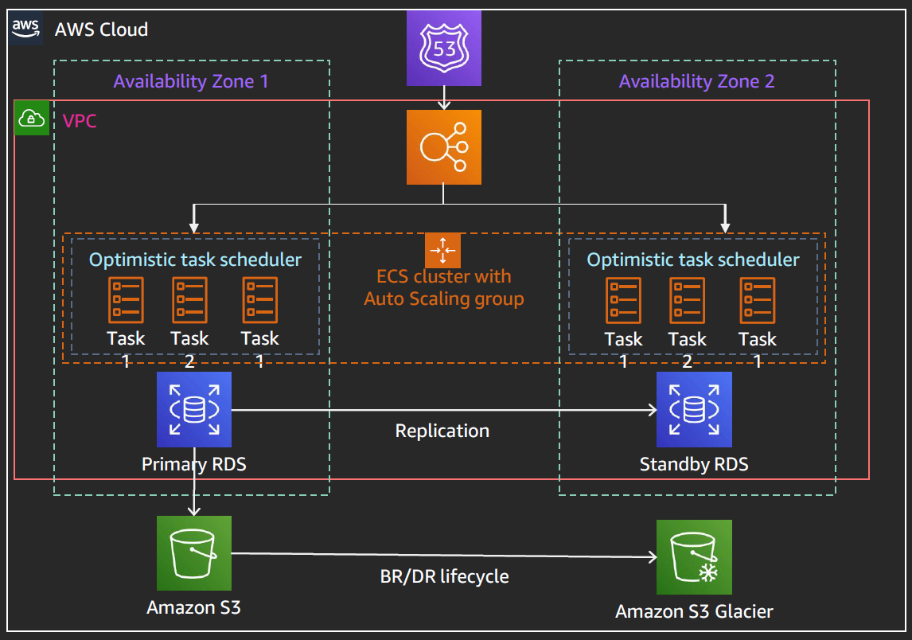
Projektni obrazac: Mikroservisi u kontejnerima
1 | OTPORAN
2 | AUTOMATSKO SKALIRANJE
3 | SIGURAN
4 | IZDRŽLJIV / TRAJAN
Notes:
Containerized microservices
otporanautomatsko skaliranjesiguranizdržljiv

Slide 19
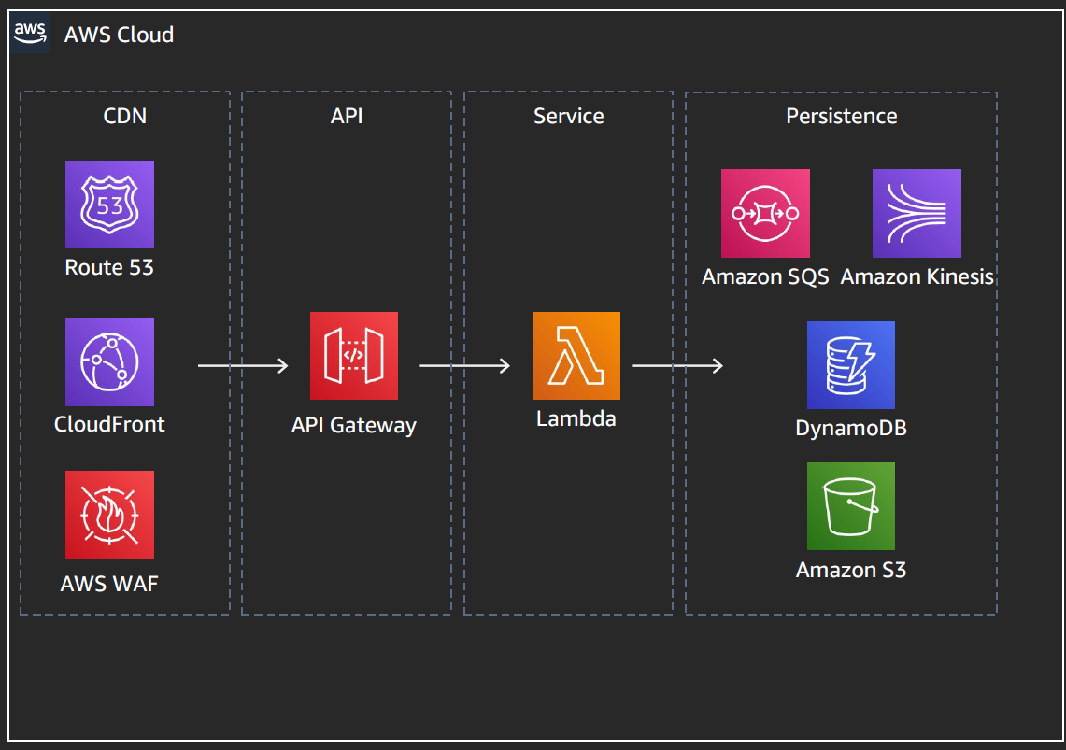
Projektni obrazac: Serverless
1 | ASINHRONI
2 | TOLERANTAN NA KAŠNJENJE
3 | NISKI TROŠKOVI VLASNIŠTVA – PAYGO
4 | SLA (service level agreement) + nizak MGMT

Slide 20
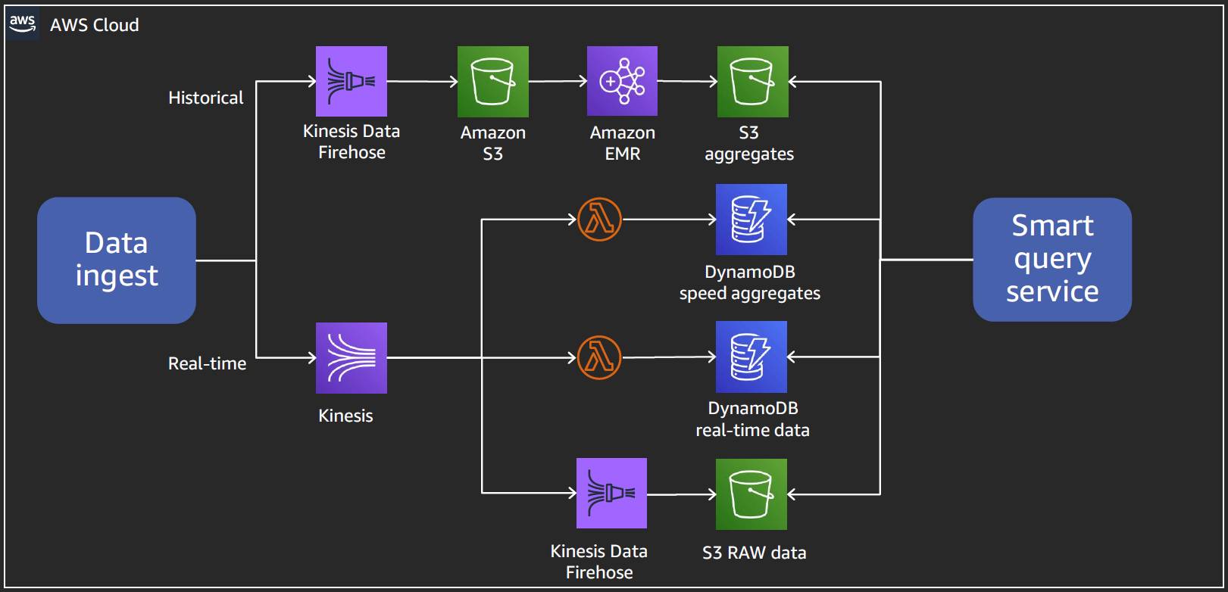
Odvojeni real-time (u realnom vremenu) i non-real-time (standardni) podaci

Slide 21
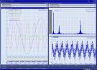
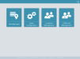

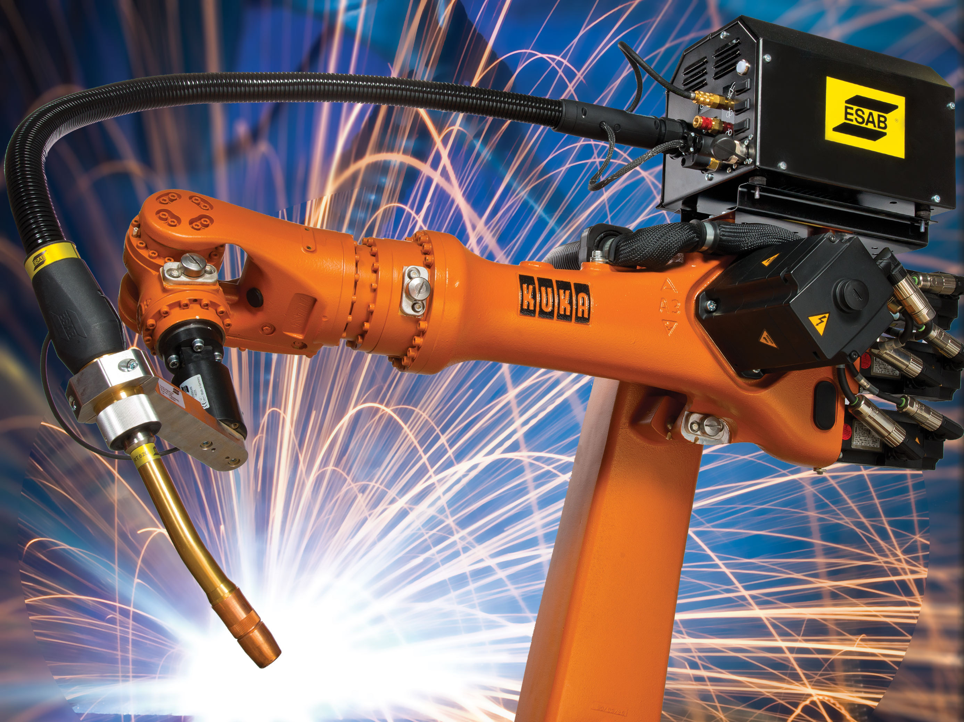
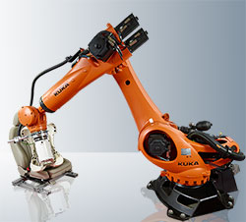
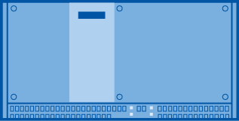


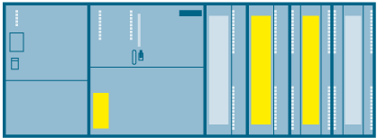
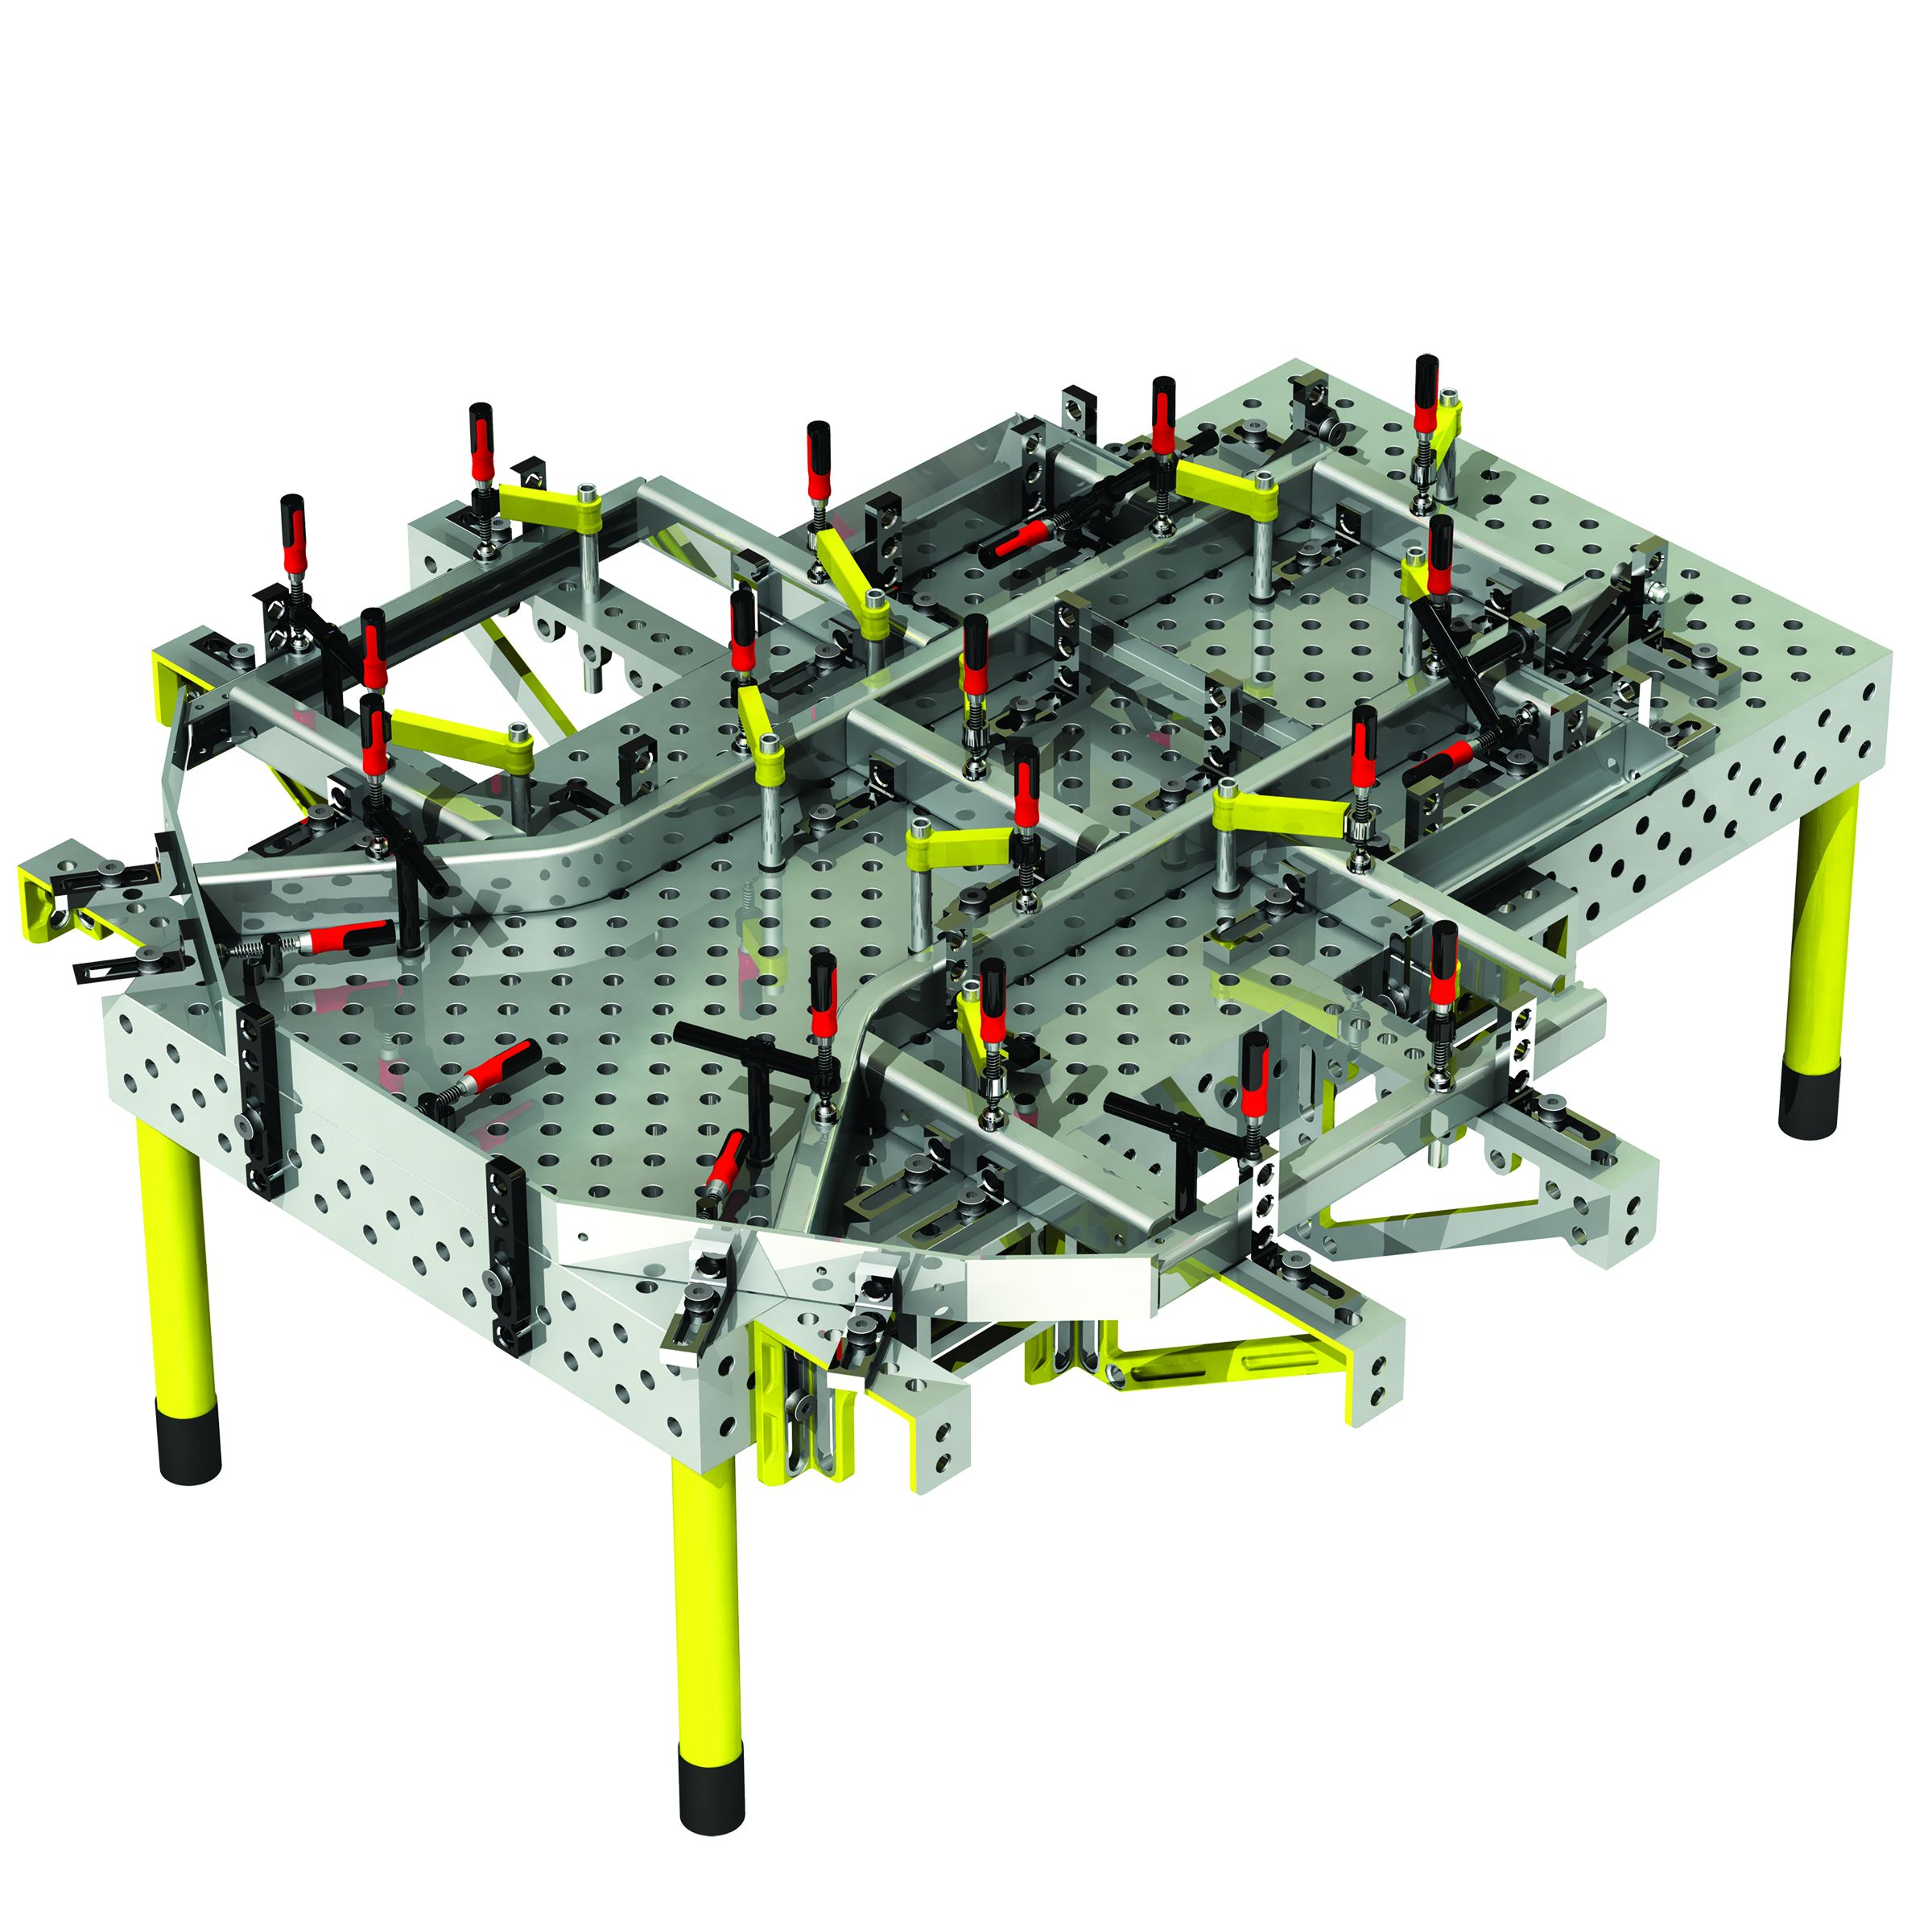
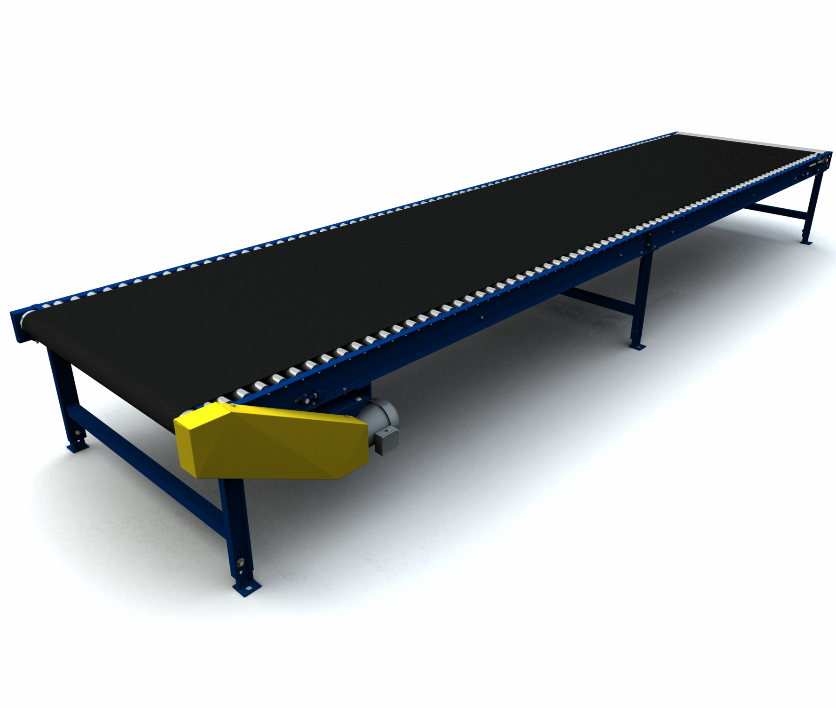
Primer Automotive Body Shop – Prediktivno održavanje
X-Tools Client
MindSphere
Kolekcija podataka velike frekvencije sa robota
Pre-obrada podataka (izračunavanje efektivne vrednosti vibracija i slanje u MindSphere-u)
Analitika na Edge nivou
Pristup dashboard-ima i MindApps
Nadzor kritičnih KPI-ova (Key Performanse Indicators)
Vizuelizacija promenljivih
Podešavanje granica za aktiviranje alarma i upozorenja
Local X-Tools Server
MindConnectNano
Weld robot
Weld robot
Manipulator
Weld cell
Microbox
Ethernet
Kuka Controller (PNIO)
Kuka Controller (PNIO)
Kuka Controller (PNIO)
Table
Conveyor
S7 319F
Ethernet (PNIO)
Page 21

Slide 22
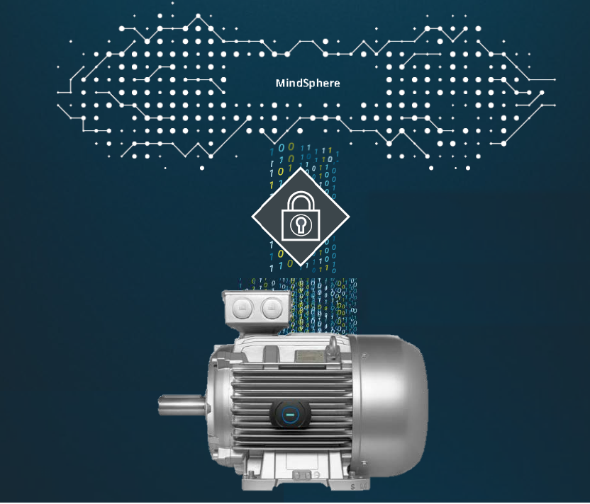
MindSphere – Nadzor stanja asset-a
Dobijte pregled o statusu vašeg aseta, na primer:
Elektronska pločica sa podacima o nominalnim vrednostima,
Trenutno stanje motora,
Lokacija asseta
Biće dostupno za motore u osnovnim primenama kao što su kompresori, pumpe i ventilatori.
Notes:
Get an overview about the status of your assets e.g.:
Electronic rating plate,
Motor health conditions,
Asset location,
Performance
Will be available for motors within basic applications such as compressors, pumps and fans.

Slide 23
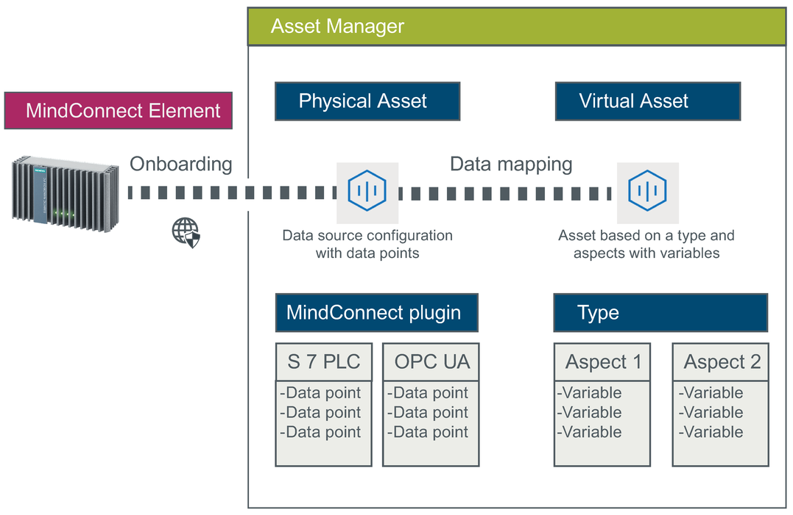
MindSphere – Model podataka

Slide 24
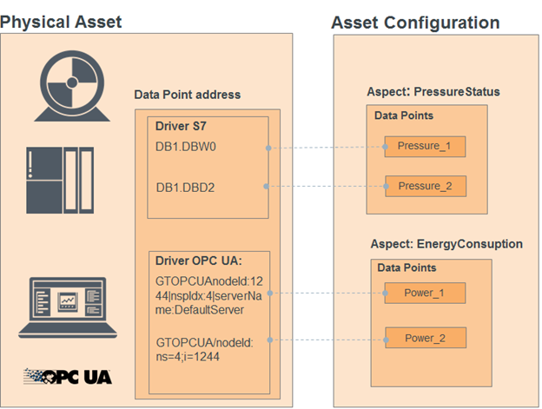
Kreiranje modela podataka – konfigurisanje asset-a
Šta je „asset“
Šta je „asset“ tip
Šta je aspekt
Šta je aspekt tip
Šta je statička varijabla
Šta je dinamička varijabla

Slide 25
MindSphere – Asset i Asset tip
„“Asset“ predstavlja digitalnu reperezentaciju fizičkog uređaja ili mašine sa jednim ili više uređaja
Siemens-ov naziv za stvari („things“).
„Asset“ može da bude:
Jedan uređaj,
Deo uređaja,
Grupa uređaja (npr. mesto gde su uređaji locirani)
Svaki „asset“ je deklarisan na osnovu „asset“ tipa. „Asset“ tip ima:
ime,
opis,
lokaciju,
matični (roditeljski) „asset“ (eng. parent asset) („asset“ je deo hijerarhije, odnosno „asset“ je hijerarhijski),
skup promenljivih i
skup aspekta koji se koriste za smeštaj (u osnovi statičkih) informacija o „asset“-u.
Notes:
Asset – the digital instance of your physical device — the root of your device’s digital twin. Assets are hierarchical and, therefore, may model a single device, parts of a device, or groups of devices such as a site where devices are located. Each asset is associated with an asset type that describes the asset such as its name, description, location, parent asset (remember that assets are hierarchical), as well as a set of custom variables and aspects.
https://edge2web.com/2019/02/12/mindsphere-primer-asset-variables-and-static-assets/

Slide 26
MindSphere – „Asset“ tip
„Asset“ tip je osnova za kreiranje modela „asset“-a
„Asset“ se ne može kreirati bez asociranja sa „asset“ tipom.
„Asset tip“ predstavlja obrazac na osnovu koga se „asset“(i) kreiraju.
„Asset“ tip je hijerarhijski – on sadrži roditeljski tip i kolekciju osobina koji definišu tipove osobina „asset“-a.
MindSphere ima više predefinisanih tipova koji se mogu koristiti kao osnova za korisničke tipove „asset“-a.
„Asset“ tip ima:
skup promenljivih,
skup aspekta koji se mogu koristiti za smeštaj (generalno statičkih) informacija o „asset“-ima.
Notes:
Asset Types – the starting point for creating an asset model that represents your digital twin. You can’t create an asset without associating it with a type. Asset types are templates from which assets are created. Asset types, like assets, are hierarchical — they have a parent type and a collection of properties that define the asset type’s characteristics. MindSphere has multiple built-in types you can use as the basis for your custom types. An asset type has a set of asset variables and aspects that can be used to store (generally static) information about the asset.
Note: It is important to create your own asset type when extending a “core” type to allow future flexibility in your asset model (like adding new variables or aspects).

Slide 27
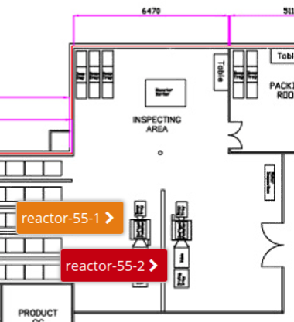
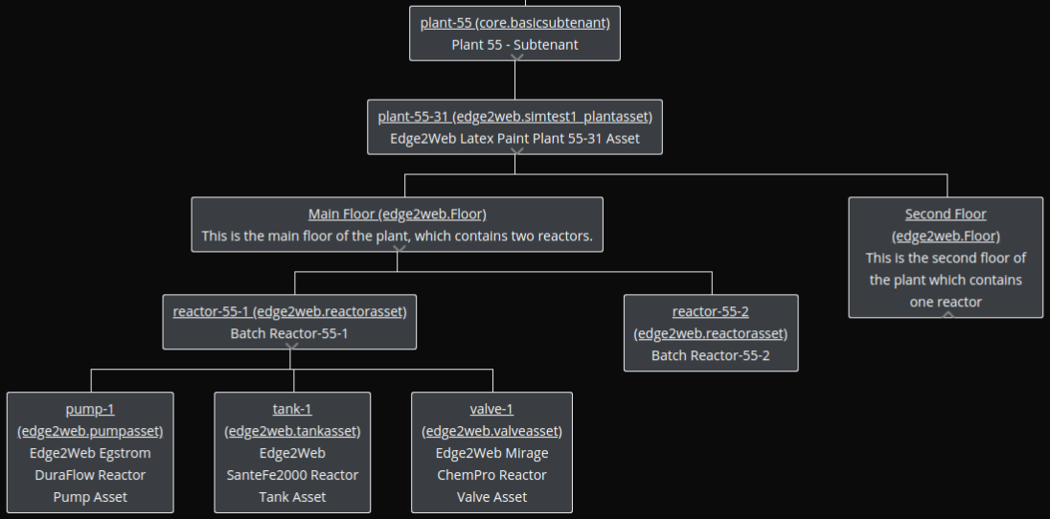
MindSphere – Hijerarhija Asset-a

Slide 28
Asset promenljiva
Promenljiva ima:
ime i
vrednost,
„Asset“ ima:
Kolekciju ime - vrednost parova
Ime promenljive i njen tip moraju biti definisani u „asset“ tipu (ili u jednom od njegovih predaka), a pre njihovog korišćenja.
Notes:
Asset Variable – a variable has a name and a value, and assets have a collection of these name-value pairs. The variable’s name and type must be defined on your asset type (or one of its ancestors) before you can use it. They are defined individually on an asset type and, thus, are not grouped and shared through inheritance. If an asset of a certain type always has a property you’d like to save with the asset, then you can use an asset variable for that property.

Slide 29
Tipovi aspekata
Aspekt predstavlja skup promenljivih koje zajedno predstavljaju osobine „asset“-a.
Aspekt može biti: „dinamički“ ili „statički“
Dinamički aspekti opisuju osobine „asset“-a koje se menjaju tokom vremena i obično imaju senzore koji prihvataju te vrednosti.
Pristup informacijama dinamičkih aspekta je omogućeno preko:
IoT vremenskih serija (IoT Time Series) i
Servisa agregacije vremenskih serija (Time Series Aggregate Services)
Statički aspekti sadrže informacije koje se ne menjaju i koje ne zahtevaju da budu praćene tokom vremena, ali mogu biti ažurirane ukoliko je to potrebno.
Statički aspekti su smešteni u samim „asset“-ima i do njih se dolazi preko samih „asset“-a.
Notes:
Aspect Type – an aspect is a set of variables that together represent related properties of an asset. An aspect can be “dynamic” or “static”. A dynamic aspect describes things that change over time and usually have sensors for gathering values. Access to dynamic aspect information is enabled through MindSphere’s IoT Time Series and Time Series Aggregate Services. A static aspect contains descriptive information (like asset variables) that doesn’t change and doesn’t need to be tracked over time, but can be edited if required. Static aspects are stored and retrieved with the asset itself.

Slide 30
Dinamički i statički tipovi aspekta
Svojstva koja se prate senzorima (metrička svojstva), a koja se menjaju tokom vremena se prate korišćenjem servisa IoT vremenskih serija (IoT Time Series Service), što znači da ova svojstva moraju biti pridružena dinamičkim tipovima aspekta.
Kada su svojstva relativno statička, (npr, fizičke dimenzije, broj modela, datum instalacije, itd.) oni mogu biti smešteni bilo u statičke tipove aspekta (static aspect type) ili promenljive „asset“-a (asset variable).
Notes:
Given MindSphere’s modeling flexiblity, where should an asset’s traits (properties, characteristics, variables, etc.) and their associated metrics be described and stored? Sensor enabled properties (metrics) that change over time should be tracked using the IoT Time Series Service, which means they must be associated with dynamic aspect types. When traits are relatively static, (e.g., physical dimensions, model number, installation date, etc.) they can be stored in either a static aspect or an asset variable.
There are a couple of reasons you would want to use a static aspect type rather than an asset variable. Let’s consider a use case for tracking dimensions of a widget asset.
Only units and data types that match exactly with the aspects and variables are available. If they are different, the aspect can’t be connected to the data point (also case sensitive).

Slide 31
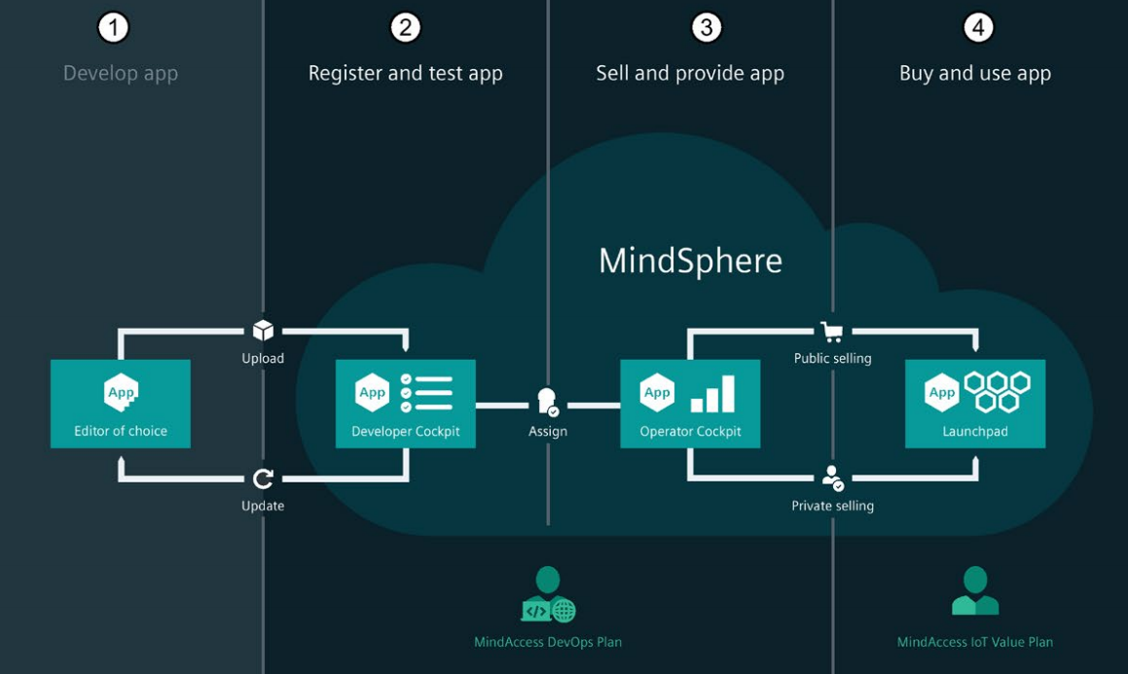
Životni ciklus aplikacije u MindSphere-i
Životni ciklus aplikacije se odvija kroz procese koji su praćeni sledećim planovima:
• Developer Plan
• Operator Plan
• IoT Value Plan
Developer Plan i Operator Plan obezbeđuju pristup do MindSphere razvojnog okruženja i objavljivanja aplikacija na MindSphere prodavnici.
Notes:
Get access to the MindSphere developer environment and publish applications to the MindSphere Store.
IoT Value Plan

Slide 32
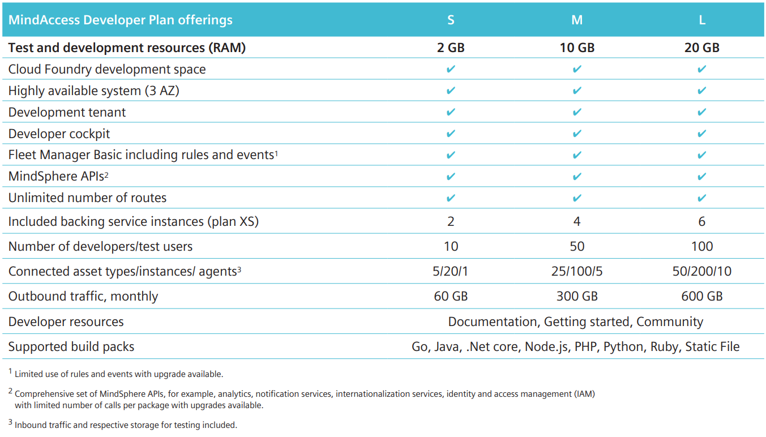
MindAccess Developer Plan

Slide 33
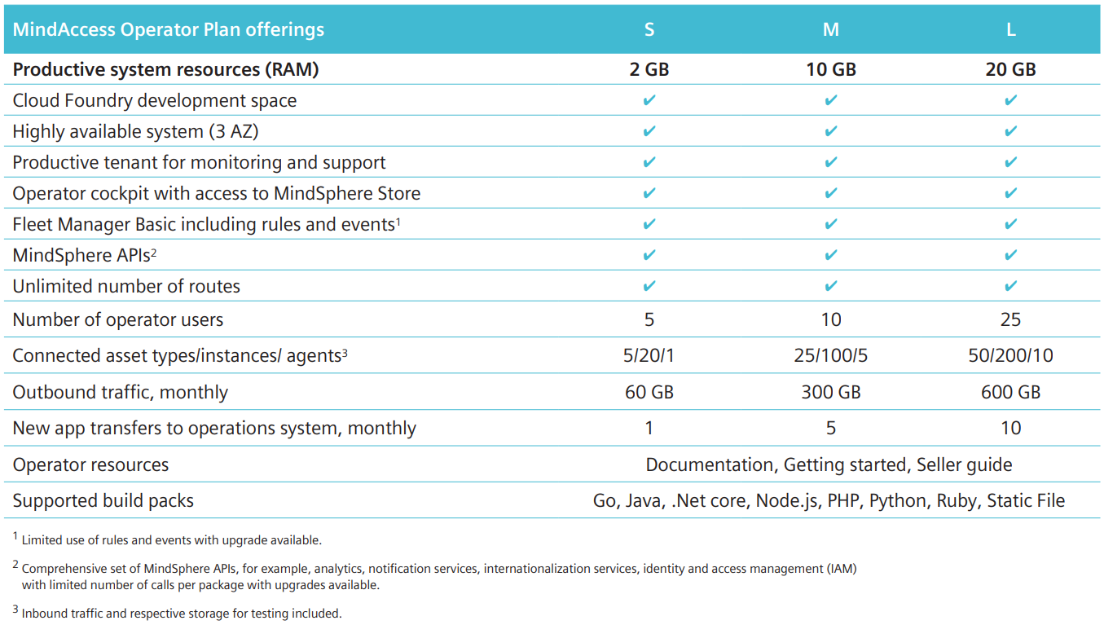
MindAccess Operator Plan

Slide 34
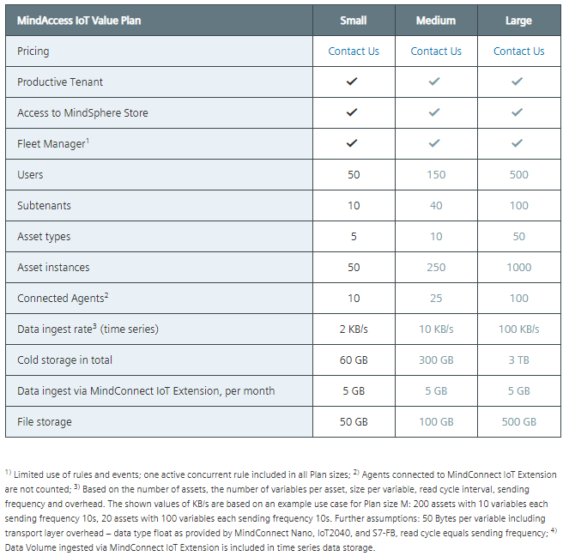
MindAccess IoT Value Plan

Slide 35
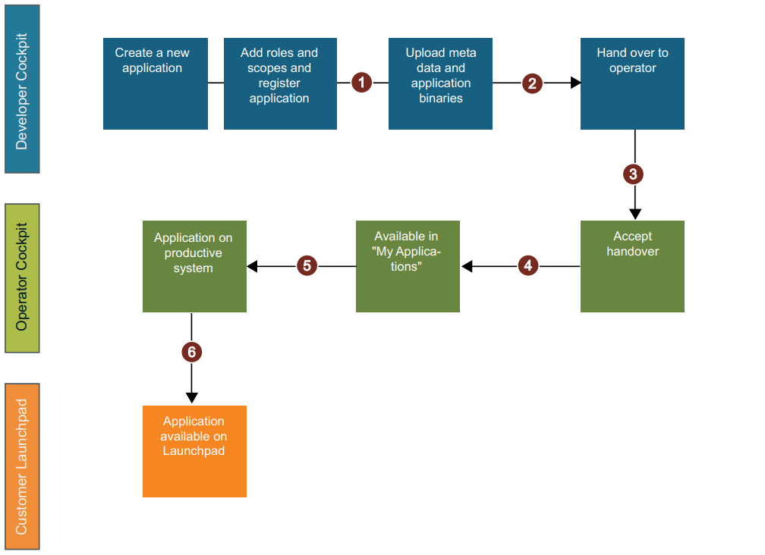
MindSphere – Razvoj aplikacije i njena predaja od operatora korisniku
Coockpiti – sistemski alati MindSphere-e
Notes:
MindSphere - Develop applications and hand over from Operator to Customer
① Create application | Add roles and scopes and register application:
• Use Developer Cockpit to create a new application.
• Add roles and scopes for the created application.
• Use Developer Cockpit for application registration.
② Upload metadata and application binaries to MindSphere:
• Upload meta data. Example - the manifest file.
• Enter service names.
• Upload zip-file with application binaries.
③ Hand over application to Operator Cockpit:
• Assign the successfully uploaded application data to a known operator.
• Operator accepts the assignment in Operator Cockpit.
④ Accept handover:
• After acceptance is received from the operator, the developer assigns the application to an operator.
• Application is then deployable for an operator inside Operator Cockpit.
⑤ Deployment in productive system:
• In Operator Cockpit, the operator deploys this application to the productive system.
• Operator can publish this application to MindSphere Store, or provision application to known customers.
⑥ Provisioning to Customer:
• In Operator Cockpit, the operator provisions the application to the known customers.
• If the operator has published an application to MindSphere Store, a subscription notification to provision to a new customer is received.

Slide 36
Developer Cockpit
Developer Cockip je sistemski alat iz MindSphere.
Developer Cockpit obezbeđuje sledeće funkcionalnosti:
Kreiranje, konfigurisanje i otpremanje stadardnih i „Fleet Manager plugin“ aplikacija
Transfer aplikacija do proizvodnog okruženja (fabričkog okruženja)
Pregled razvijenih aplikacija
Konfigurisanje aplikacija, npr. „Ikone aplikacije“ ili „Naziva aplikacije“
Obezbeđenje aplikacija na nivou krajnjih tačaka
Dovođenje aplikacija do tzv. „Launchpad“-a MindAccess Developer Plan-a
Upravljanje specifičnim ulogama same aplikacije
Promocija i prenos aplikacija iz razvojnog u proizvodno (korisničko) okruženje.

Slide 37
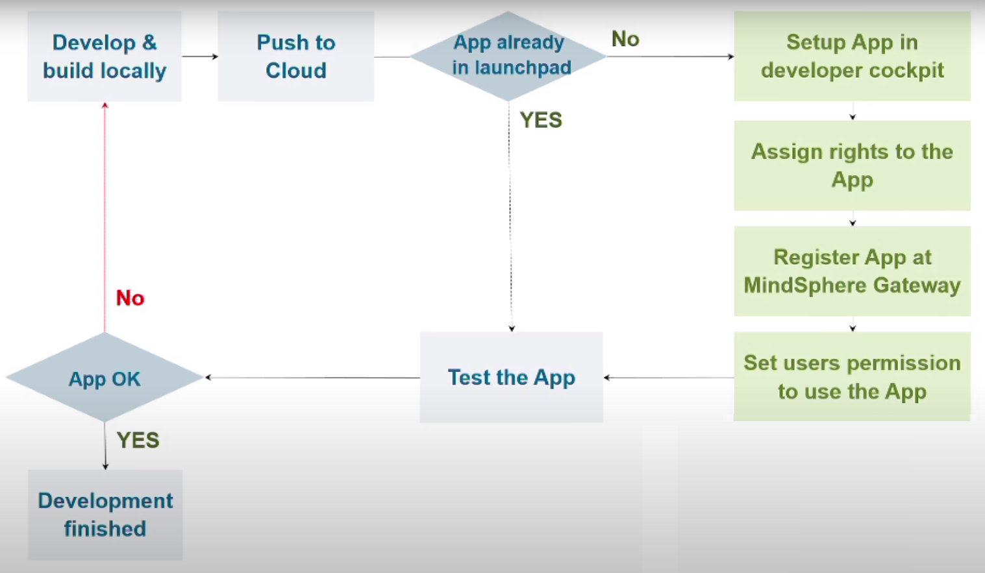
Developer Cockpit
Aplikacija mora da prođe kroz sledeće korake u sekvencijalnom redosledu u razvojnom Cockpit-u pre nego postane dostupna u „LaunchPad“-u:
Kreiranje
Registracija
Otpremanje aplikacije
Faze:
U razvoju
Priprema u toku
Čekanje na odobrenje
Provera u toku
Provera nije uspela
Za aplikaciju koja je uspešno prošla proveru sledeće stanje je „Ready for assignment“.
Notes:
In Development
Preparation in progress
Waiting for approval
Check in progress
Check failed - if uploads do not match
For passed applications, the next state is "Ready for assignment".

Slide 38
Operator Cockpit
Operator Cockpit omogućava sledeće:
Prihvatanje prenosa aplikacije iz MindAccess Developer Account-a u vaš MindAccess Operator Account.
Postavljanje aplikacije u vaše proizvodno (radno) okruženje i rad sa njom.
Pregled svih aplikacija koje rade u okviru vašeg MindAccess Operator Account-a.
Dobijanje informacije o upotrebi i prometu vaših aplikacija.
Provera statusa ispravnosti svih vaših aplikacija.
Prijem i prikaz obaveštenja u vezi sa vašim aplikacijama.
Izdavanje vaših ponuda u MindSphere prodavnici.
Otpremanje novih aplikacija u prodavnicu i pravljenje vidljiim bilo specifičnom kupcu ili javnosti.
Pružanje aplikacija novim kupcima u MindSphere prodavnici.
Dobijanje informacija o novim pretplatama sa MindSphere prodavnice.
Činjenje dostupnim aplikacija pretplatnicima MindAccess IoT Value Plan-a (i njihovim korisnicima) na bazi App Customer Contract-a između vas i takvih pretplatnika.

Slide 39
MindSphere Open Source alati i biblioteke
MindSphere CLI - pristup preko sktiptova do uobičajenih komandi MindSphere-e (onboard, kreiranje izvora podataka, kreiranje agenata, kreiranje događaja u MindSphere-i, …)
MindConnect-NodeJS - biblioteka za kreiranje korisničkih agenata u node.js-u,
MindSphere TypeScript SDK - podrška za razvoj frontend i backend aplikacija u node.js-u, sa podrškom za više različitih tipova MindSphere autentifikacija (provere autentičnosti). Sadrži implementacije klijenata za više MindSphere API-a.
MindConnect Node-RED Node - obezbeđuje pristup MindSphere-i u Node-RED-u (node za Node-RED),
MindSphere Development Proxy – krajnja tačka koja će odraditi proveru autentičnosti za sve zahteve upućene ka MindSphere API-ima
Start for Free Demo App – aplikacija koja se koristi za uvid u postupak razvoja MindSphere aplikacija. Aplikacija koristi React, MindSphere Designe System i MindSphere Web Components i drugi alati i biblioteke
Izvor: https://opensource.mindsphere.io/index.html
Notes:
https://opensource.mindsphere.io/docs/mindconnect-nodejs/sdk/index.html
https://sn0wcat-92713.medium.com/how-to-create-mindsphere-artefacts-from-json-schema-definitions-1b2f3e446f6a

Slide 40
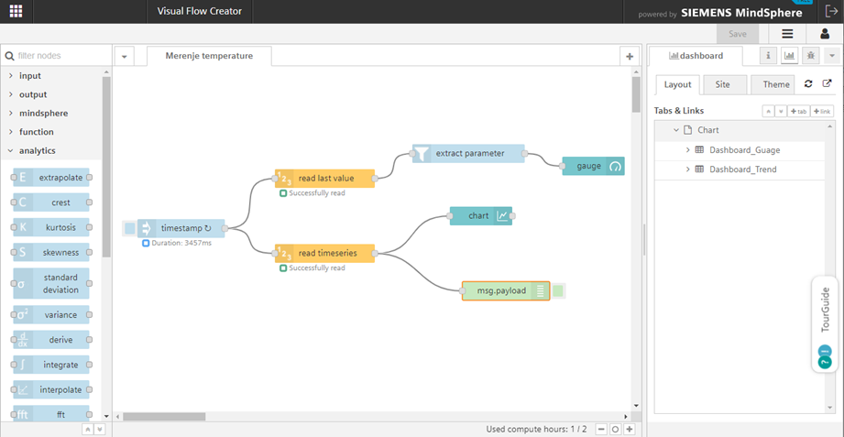
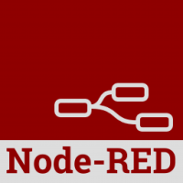
MindSphere - Visual Flow Creator
Visual Flow Creator je komponenta unutar MindSphere-e. Ona je izvedena iz Node-RED alata razvijenog od IBM-a.

Slide 41
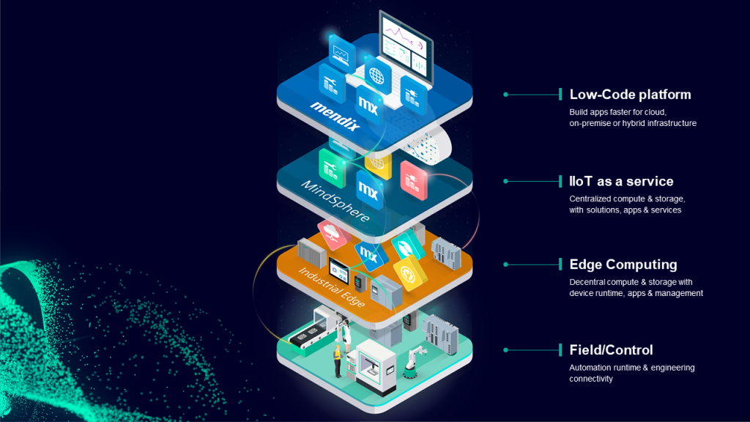
MindSphere is part of Siemens Industrial IoT

Slide 42
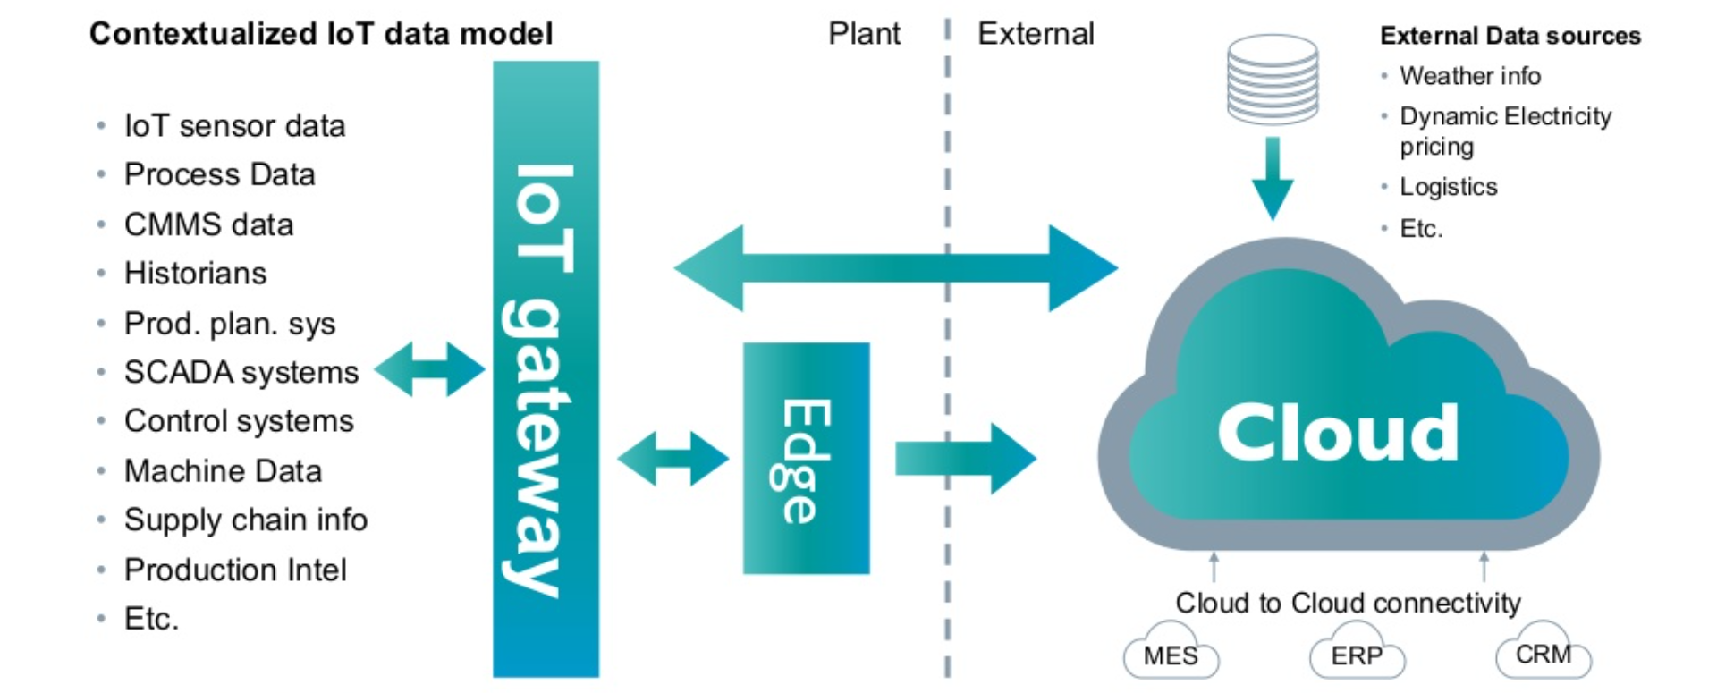
Implementation of an holastic IIoT system

Slide 43
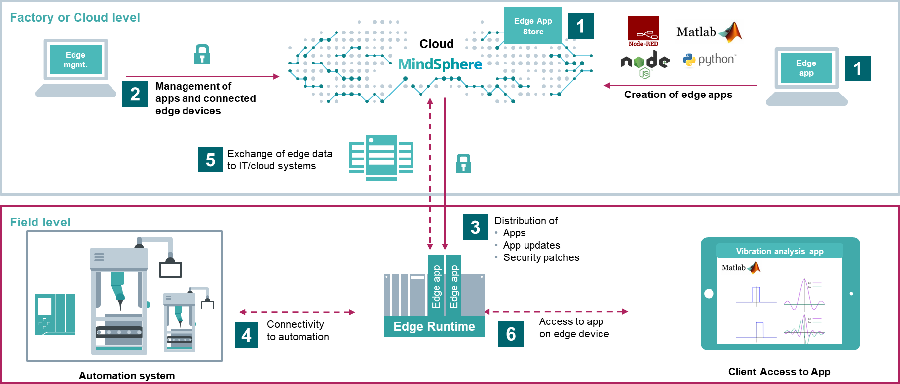
Industrial Edge, the SIEMENS Edge Computing Platform
Notes:
https://documentation.mindsphere.io/resources/html/Industrial+Edge+Developer+Environment/en-US/user-docu/industrialedge.html
Industrial Edge is the SIEMENS platform to host applications from different vendors on a computing platform close to the shopfloor.

Slide 44
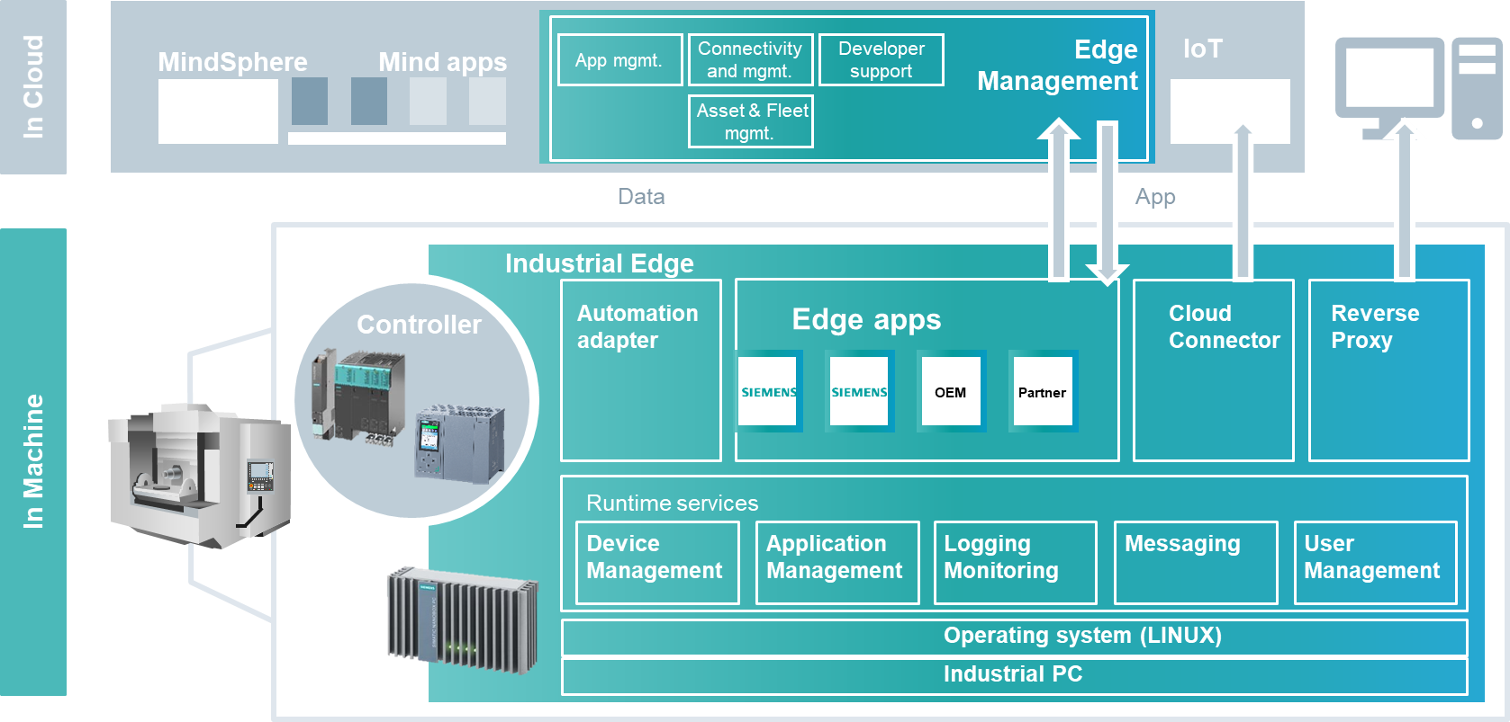
MindSphere, Industrial Edge - Architectural Concept

Slide 45
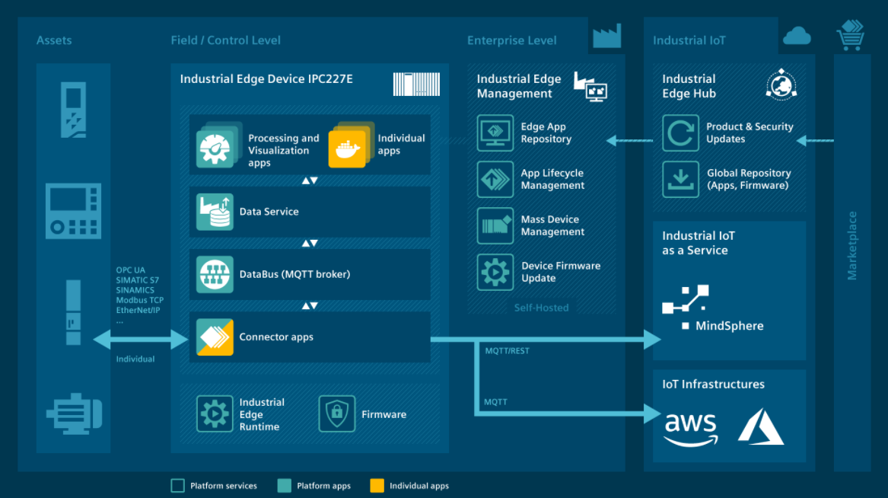
Complete solution for Edge computing in industry

